Slide 1
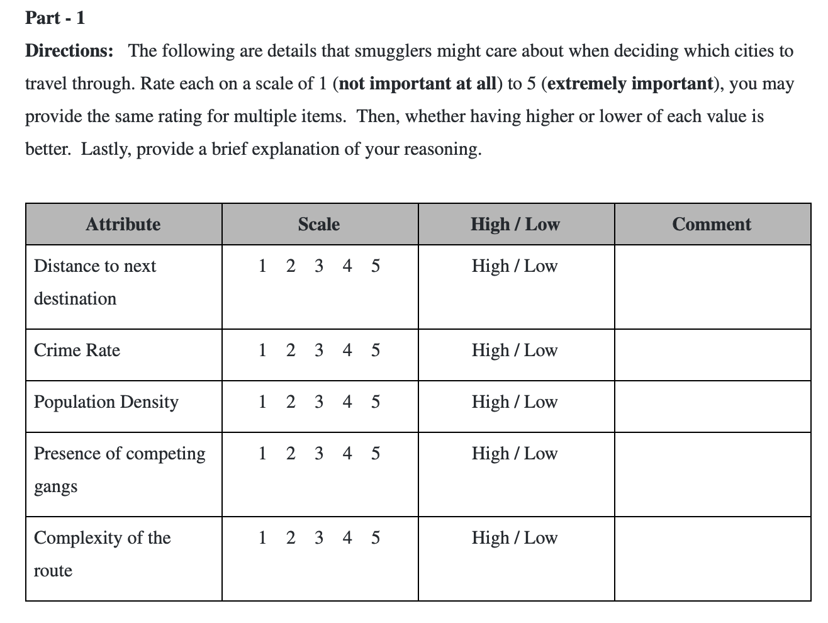


Method: Forced-choice Survey
Notes:
For part 1, participants rate the importance of distance, crime rate, population density, presence of competing gangs, and route complexity on a scale of 1-5. 1 being not at all important to smugglers and 5 being extremely important. These 5 variables were derived from previous liuterature on smuggling. We also left some some room so that we can collect data about directionality and for the participants to leave a brief explaination of their reasoning.

Slide 2
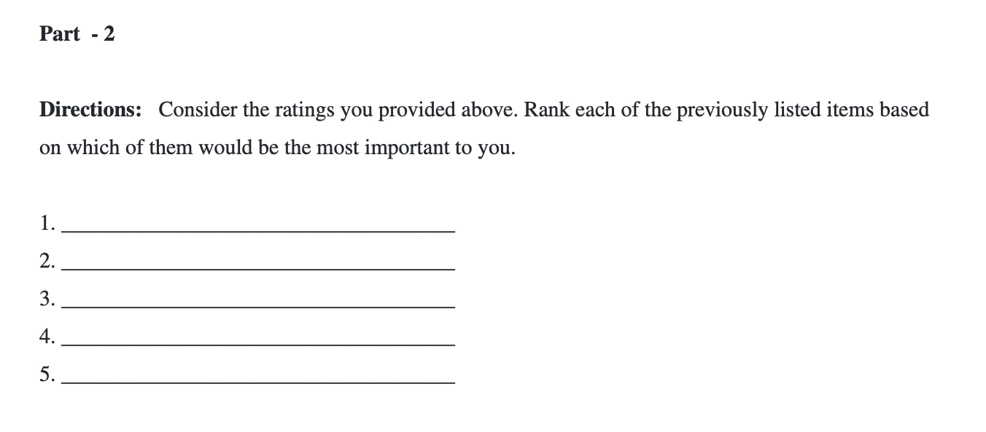
Method: Forced-choice Survey
Notes:
For part 2, they simply list the previous 5 variables from most to least importance. Having the relative rank and invidual rating for each of these variables allows us to more confidently combine their scores into one.

Slide 3
Method: Exploratory Survey
Topics will span:
Extortion and solicitation
Corruption
Illegal activity passing through customs
Demographics of respondents
Regional Conflicts
Purpose:
Collect local information to improve our understanding of how trafficking may be influenced by conditions in the MENA region
Participants:
Individuals who live in the Middle East and Africa
Notes:
The final survey that we developed, called the regional influence questionnaire, was primarily designed for future studies. In the regional influence questionnaire, we collect demographic information as well as data about local conflicts that could influence routing in the region. The intent is to distribute this survey in MENA so that we can better inform our model when we apply this methodology to artifact smuggling in the Middle East.

Slide 4
Method: Exploratory Survey, Pilot Study
Given the nature of this survey, the pilot study primarily served as a vetting opportunity to improve the questions and their structure.
The survey took participants no longer than 15 minutes to complete, with some completing the questions in under 5 minutes.
Feedback included:
Likert scale standardization
Additional questions to obtain more demographic information
Clarification specifically on question 10, regarding impact of personal belief on display of artifacts
Future work includes:
Incorporating feedback into survey structure
IRB Plan: We have completed and plan to file an exemption form to UCF’s IRB
Notes:
The current pilot study was an opportunity for us to vet both our Regional Influence Questionnaire and our Route Decision Questionnaire. Both studies were completed in under 15 minutes with some participants finishing in under 5 minutes. We received some feedback about our use of Likert scales and our collection of demographic information, but we have not had an opportunity to incorporate that feedback into our final graph model.
In the future, we plan to incorporate the feedback we received and file an exemption for to UCF’s IRB so that we can collect data.

Slide 5
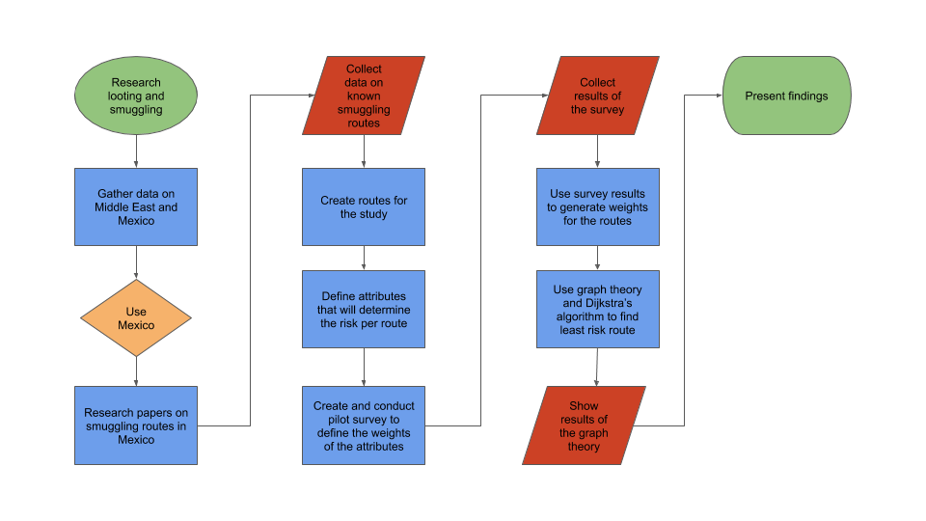
Workflow

Slide 6
City Information
City Information was gathered from several sources
City information was researched for crime rate, population, and cartel controlled
The data was tabulated for each of the cities defined in the routes
City | Crime Rate | Population | Cartel
Aguascalientes | 6.8 | 905,908 | Tierra Caliente
Celaya | 38.2 | 513,690 | Tierra Caliente
Ciudad Valles | 19.5 | 184,262 | Tamaulipas
Ciudad Victoria | 29.3 | 368,317 | Tamaulipas
Fresnillo | 42.3 | 231,904 | Tamaulipas
Sample table of city information

Slide 7
Route Information
Route information was determined from several resources
The linear distance was calculated from Google Earth
Path distance was determined from Google Maps
The circuitry was calculated for each route
The destination city’s population, crime rate, and cartel information was assigned to the routes
Route | Linear Distance (mi) | Path Distance (mi) | Circuity | Destination City Crime Rate | Destination Population
Zihuatanejo to Huetamo | 75.9 | 162.0 | 2.1 | 28.6 | 49,031
Zihuatanejo to Nueva Italia de Ruiz | 97.4 | 125.0 | 1.3 | 4.7 | 42,605
Nueva Italia de Ruiz to Uruapan | 25.3 | 36.2 | 1.4 | 74.6 | 348,643
Sample table of route information

Slide 8
Forced-Choice Survey: Results
The survey results were collected and processed to determine the weights of the route attributes
The attributes of ranking and score were used to calculate a composite values to be applied to the route’s attributes
The high/low was used to determine is a high or low value for a attribute equated to a risk level
Attribute | Score | Low/High | Ranking | Composite
Presence of Competing Gangs | 4.71 | Low | 1.86 | 3.93
Distance to Next Destination | 3.86 | Low | 2.43 | 3.21
Crime Rate | 3.14 | High | 3.14 | 2.50
Population Density | 2.86 | Low | 3.71 | 2.07
Complexity of the Route | 2.86 | Low | 3.86 | 2.00
Survey results and composite values

Slide 9
Route Weights
The route weights were calculated from the attributes of the routes and the survey results
The attributes for the routes were normalized between 0 and 1 using the min and max value for each attribute
The route’s attribute was multiplied by the survey composite values to form a weight for each route
The weight equates to the level of risk along each route segment
Route | Distance | Circuity | Crime | Population | Cartel | Route Weight
Zihuatanejo to Huetamo | 0.42 | 0.21 | 0.38 | 0.97 | 0.00 | 4.74
Zihuatanejo to Nueva Italia de Ruiz | 0.58 | 0.83 | 0.06 | 0.97 | 0.00 | 5.72
Nueva Italia de Ruiz to Uruapan | 0.98 | 0.72 | 1.00 | 0.78 | 0.00 | 8.73
Huetamo to Morelia | 0.57 | 0.51 | 0.55 | 0.50 | 0.00 | 5.28
Example of route weight data

Slide 10
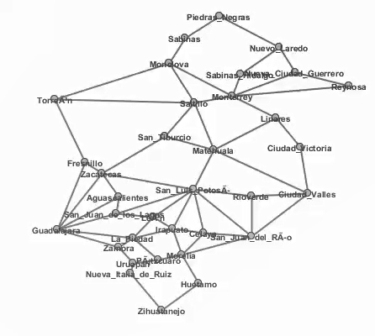
Graph Theory: Results
The routes with their respective weights were entered into Graph Tea
The cities were defined with the nodes
The routes were defined as edges with weights

Slide 11
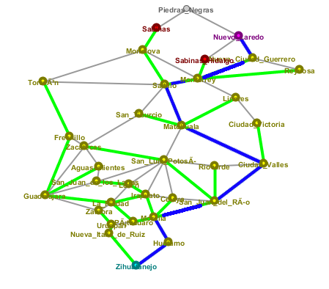
Graph Theory: Results
The path with the least amount of risk was determined
Within Graph Tea, the Dijkstra Algorithm was ran
The algorithm used the weights to determine the path with the least weights, in this case risk level
The path is shown below with the blue lines representing the route with the least amount of risk

Slide 12
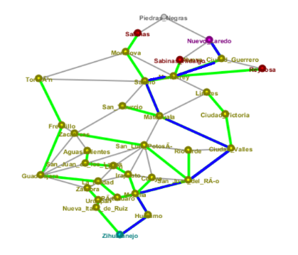
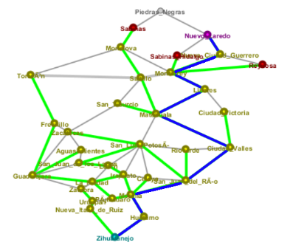
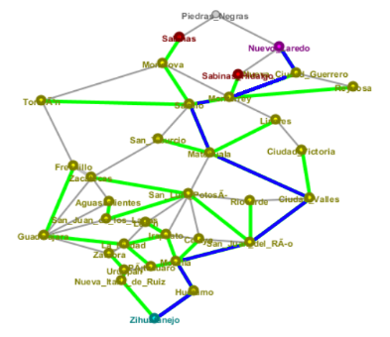
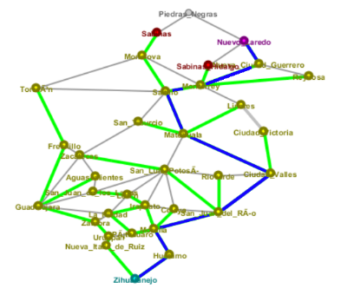
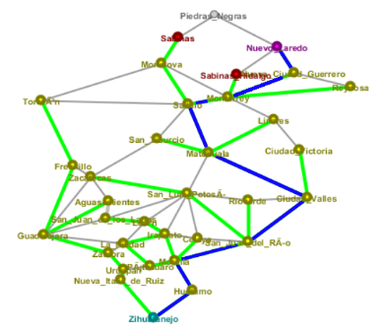
Graph Theory: Results
For completeness, a sensitivity analysis was conducted:
Within Graph Tea, the Dijkstra Algorithm was ran with four attributes only
The paths shown below confirm that the model is not highly sensitive to changes in input variables
Distance, Crime, Circuity, Population, Cartel Presence | Circuity, Crime, Population, Cartel Presence | Distance, Circuity, Crime, Cartel Presence | Distance, Circuity, Crime, Population | Distance, Circuity, Population, Cartel Presence | Distance, Crime, Population, Cartel Presence

Slide 13
Conclusion & Future Work
In conclusion, this project serves as a proof of concept for use of graph theory to predict routes
Within the time constraints of the project, several strengths and weaknesses have been identified about the model
Highly customizable and scalable
Requires more robust processes to calculate weights for model input
Additional analyses suggest that the generated model is not sensitive to changes in input variables, suggesting model stability
Future work includes
Apply model to MENA region
Conduct Regional Influence Survey
Adjust model attributes accordingly
Run model with locations from MENA
Greater sensitivity analyses
Incorporate additional KML data
Further project validation
Collecting data on locations where traffickers have been apprehended
Collecting first-hand experiences to test against model
Notes:
This project serves as a pilot study for using graph models to predict smugglings routes. Using graph theory presents a couple of pros and cons. The strength of our approach is that it is highly customizable and saleable. Using this same approach, we could build models to predict smugglings in the Middle east or Europe. Likewise, by using more nodes in the graph, we could increase the resolution of our model to make precise predictions.
The down side is that our approach requires a human-subjects data collection process in order to gather model inputs. This could be an obstacle depending on the region we are making predictions for.
In the future, we plan to apply our model to make predictions in MENA. Additionally, we will use historical data to try and validate the accuracy of our models predictions.

Slide 14
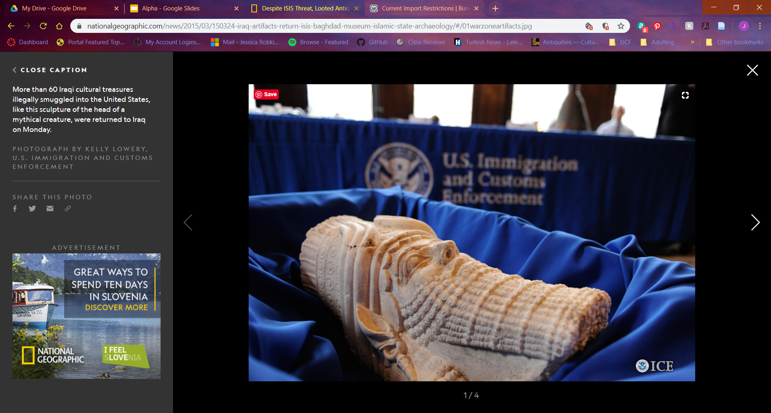


QUESTIONS?
Visit our GitHub repository for more information

Slide 15
REFERENCES
Alderman, K. L. (n.d.). Honor Amongst Thieves: Organized Crime and the Illicit Antiquities Trade. Indiana Law Review, 45, 27.
Barker, A. (2018a, June 5). Tracking the smugglers’ trail of priceless Islamic State loot to art markets in the West. Retrieved September 27, 2019, from ABC News (Australian Broadcasting Corporation website: https://www.abc.net.au/news/2018-06-06/priceless- antiques-looted-by-is-smuggled-into-western-markets/9833554
Barker, A. (2018b, June 6). A one-ton mosaic likely stolen from Syria turns up in the West. It’s the “tip of the iceberg” [Text]. Retrieved September 27, 2019, from ABC News website: https://www.abc.net.au/news/2018-06-06/priceless-antiques-looted-by-is-smuggled-into-western-markets/9833554
Barthélemy, J., & Carletti, T. (2017). An adaptive agent-based approach to traffic simulation. Transportation Research Procedia, 25, 1238–1248. https://doi.org/10.1016/j.trpro.2017.05.142
Barzoukas, G., & Institute for Security Studies (Paris, F. (2017). Drug trafficking in the MENA: The economics and the politics. Retrieved from http://dx.publications.europa.eu/10.2815/972478
Basu, G. (2013). The role of transnational smuggling operations in illicit supply chains. Journal of Transportation Security, 6(4), 315–328. https://doi.org/10.1007/s12198-013-0118-y
Basu, G. (2014). The strategic attributes of transnational smuggling: Logistics flexibility and operational stealth in the facilitation of illicit trade. Journal of Transportation Security, 7(2), 99–113. https://doi.org/10.1007/s12198-013-0132-0
Beittel, J. S. (n.d.). Mexico: Organized Crime and Drug Trafficking Organizations. 35.
Blannin, P. (2017). Islamic State’s Financing: Sources, Methods and Utilisation. 9(5), 11.
Blythe Bowman Proulx. (2013). Archaeological Site Looting in “Glocal” Perspective: Nature, Scope, and Frequency. American Journal of Archaeology, 117(1), 111. https://doi.org/10.3764/aja.117.1.0111
Brodie, N., & Mackenzie, S. (2014). Trafficking Cultural Objects: Introduction. European Journal on Criminal Policy and Research, 20(4), 421–426. https://doi.org/10.1007/s10610-014-9256-4
Brodie, N., & Renfrew, C. (2005). Looting and The World’s Archaeological Heritage: The Inadequate Response. Annual Review of Anthropology, 34(1), 343–361. https://doi.org/10.1146/annurev.anthro.34.081804.120551
Broek, A. C. van den, Schoemaker, R. M., & Dekker, R. J. (2014). Land Border Permeability and Irregular Migration Using Geospatial Intelligence from Satellite Data. 2014 IEEE Joint Intelligence and Security Informatics Conference, 208–211. https://doi.org/10.1109/JISIC.2014.38
Brunsdon, C., & Singleton, A. (2015). Geocomputation: A Practical Primer. https://doi.org/10.4135/9781473916432
Campbell, P. B. (2013). The Illicit Antiquities Trade as a Transnational Criminal Network: Characterizing and Anticipating Trafficking of Cultural Heritage. International Journal of Cultural Property, 20(2), 113–153. https://doi.org/10.1017/S0940739113000015
Casana, J. (2015). Satellite imagery-based analysis of archaeological looting in Syria. Near Eastern Archaeology, 78(3), 142–152.
Casana, & Panahipour. (2014). Satellite-Based Monitoring of Looting and Damage to Archaeological Sites in Syria. Journal of Eastern Mediterranean Archaeology & Heritage Studies, 2(2), 128. https://doi.org/10.5325/jeasmedarcherstu.2.2.0128
Danese, M., Masini, N., Biscione, M., & Lasaponara, R. (2014). Predictive modeling for preventive Archaeology: Overview and case study. Open Geosciences, 6(1). https://doi.org/10.2478/s13533-012-0160-5
Felner, A. (n.d.). Position Paper: Dijkstra’s Algorithm versus Uniform Cost Search or a Case Against Dijkstra’s Algorithm. 5.
Graph Theory Types of Graphs—Javatpoint. (n.d.). Retrieved December 8, 2019, from Www.javatpoint.com website: https://www.javatpoint.com/graph-theory-types-of-graphs
Grayson, G. W. (2014). The Evolution of Los Zetas in Mexico and Central America: Sadism as an Instrument of Cartel Warfare: https://doi.org/10.21236/ADA599872
Greenland, F. (2019). Introduction: New Insights into the Antiquities Market. International Journal of Cultural Property, 26(3), 211–225. https://doi.org/10.1017/S0940739119000237
Inside the hunt for Iraq’s looted treasures. (2019, July 10). Retrieved September 27, 2019, from The Independent website: https://www.independent.co.uk/news/world/middle-east/iraq-archaeology-museum-antiquities-looting-a8996676.html
Jenkins, J. L., Marquardson, J., Proudfoot, J. G., Valacich, J. S., Golob, E., & Nunamaker, J. F. (2013). The Checkpoint Simulation: A Tool for Informing Border Patrol Checkpoint Design and Resource Allocation. 2013 European Intelligence and Security Informatics Conference, 252–255. https://doi.org/10.1109/EISIC.2013.65
Jordan, C. (2016, December 17). New leads on looted Middle Eastern antiquities [Text]. Retrieved September 27, 2019, from TheHill website: https://thehill.com/blogs/congress-blog/foreign-policy/310831-new-leads-on-looted-middle-eastern-antiquities
Latek, M. M., Rizi, S. M. M., Crooks, A., & Fraser, M. (2012). Social Simulations for Border Security. 2012 European Intelligence and Security Informatics Conference, 340–345. https://doi.org/10.1109/EISIC.2012.50
Luke, C., & Kersel, M. (2005). A Retrospective and a Look Forward. Journal of Field Archaeology, 30(2), 191–200. https://doi.org/10.1179/009346905791072323
Madella, M., Rondelli, B., Lancelotti, C., Balbo, A., Zurro, D., Campillo, X. R., & Stride, S. (2014). Introduction to Simulating the Past. Journal of Archaeological Method and Theory, 21(2), 251–257. https://doi.org/10.1007/s10816-014-9209-8
Medel, M., Lu, Y., & Chow, E. (2015). Mexico’s drug networks: Modeling the smuggling routes towards the United States. Applied Geography, 60, 240–247. https://doi.org/10.1016/j.apgeog.2014.10.018
Parcak, S., Gathings, D., Childs, C., Mumford, G., & Cline, E. (2016). Satellite evidence of archaeological site looting in Egypt: 2002–2013. Antiquity, 90(349), 188–205. https://doi.org/10.15184/aqy.2016.1
Parks, S., Mcanany, P. A., & Murata, S. (2006). The Conservation of Maya Cultural Heritage: Searching for Solutions in a Troubled Region. Journal of Field Archaeology, 31(4), 425–432. https://doi.org/10.1179/009346906791071846
Rodríguez-Puente, R., & Lazo-Cortés, M. S. (2013). Algorithm for shortest path search in Geographic Information Systems by using reduced graphs. SpringerPlus, 2(1), 291. https://doi.org/10.1186/2193-1801-2-291
Rose-Greenland, F. (2014). Looters, collectors and a passion for antiquities at the margins of Italian society. Journal of Modern Italian Studies, 19(5), 570–582. https://doi.org/10.1080/1354571X.2014.962256
Samuel, S. (2018, March 19). It’s Disturbingly Easy to Buy Iraq’s Archeological Treasures. Retrieved September 27, 2019, from The Atlantic website: https://www.theatlantic.com/international/archive/2018/03/iraq-war-archeology-invasion/555200/
Sellers, W. I., Hill, R. A., & Logan, B. S. (2007). An agent-based model of group decision making in baboons. Philosophical Transactions of the Royal Society B: Biological Sciences, 362(1485), 1699–1710. https://doi.org/10.1098/rstb.2007.2064
Sørensen, M. L. S., & Viejo-Rose, D. (Eds.). (2015). War and Cultural Heritage: Biographies of Place. New York, NY: Cambridge University Press.
Stealing from history: The looting and destruction of Iraqi and Syrian heritage concern us all. (n.d.). Retrieved April 2, 2019, from The National website: https://www.thenational.ae/arts-culture/stealing-from-history-the-looting-and-destruction-of-iraqi-and-syrian-heritage-concern-us-all-1.308011
Sullivan, B. L. (n.d.). Stolen artifacts finding way into the world’s art markets. Retrieved September 27, 2019, from Baltimoresun.com website: https://www.baltimoresun.com/bal-te.fbi22apr22-story.html
Swann, S. (2019, May 2). “Loot-to-order” antiquities sold on Facebook. BBC News. Retrieved from https://www.bbc.com/news/world-middle-east-47628369
Visconti, A. (n.d.). Professor of Criminal Law, University of Naples II, Italy; Visiting Professor, Queen Mary University of London, UK; ISPAC Deputy Chair and Director. 210.
Wang, X. Z. (2018). The Comparison of Three Algorithms in Shortest Path Issue. Journal of Physics: Conference Series, 1087, 022011. https://doi.org/10.1088/1742-6596/1087/2/022011
Xue, G., Li, Z., Zhu, H., & Liu, Y. (2009). Traffic-Known Urban Vehicular Route Prediction Based on Partial Mobility Patterns. 2009 15th International Conference on Parallel and Distributed Systems, 369–375. https://doi.org/10.1109/ICPADS.2009.129

Slide 16
Backup

Slide 17
City Information
City | Crime Rate | Population | Cartel
Aguascalientes | 6.8 | 905908 | Tierra Caliente
Celaya | 38.2 | 513690 | Tierra Caliente
Ciudad Valles | 19.5 | 184262 | Tamaulipas
Ciudad Victoria | 29.3 | 368317 | Tamaulipas
Fresnillo | 42.3 | 231904 | Tamaulipas
Guadalajara | 22.5 | 1538374 | Shared
Huetamo | 28.6 | 49031 | Tierra Caliente
Irapuato | 53.7 | 584276 | Tierra Caliente
La Piedad | 22.3 | 107696 | Tierra Caliente

Slide 18
City Information
City | Crime Rate | Population | Cartel
León | 26.5 | 1575400 | Tierra Caliente
Linares | 0.0 | 89441 | Tamaulipas
Matehuala | 21.4 | 102579 | Tamaulipas
Monclova | 6.7 | 240033 | Tamaulipas
Monterrey | 17.1 | 1226064 | Shared
Morelia | 41.2 | 786782 | Tierra Caliente
Nueva Ciudad Guerrero | 0.0 | 5371 | Tamaulipas
Nueva Italia de Ruiz | 4.7 | 42605 | Tierra Caliente
Nuevo Laredo | 15.2 | 432926 | Tamaulipas

Slide 19
City Information
City | Crime Rate | Population | Cartel
Pátzcuaro | 14.7 | 95335 | Tierra Caliente
Piedras Negras | 7.1 | 168297 | Tamaulipas
Reynosa | 30.9 | 718857 | Tamaulipas
Rioverde | 10.0 | 100293 | Tamaulipas
Sabinas | 2.9 | 69718 | Tamaulipas
Sabinas Hidalgo | 10.3 | 38888 | Tamaulipas
Saltillo | 3.2 | 825244 | Tamaulipas
San Juan de los Lagos | 13.3 | 74932 | Tierra Caliente
San Juan del Río | 13.5 | 280960 | Tierra Caliente

Slide 20
City Information
City | Crime Rate | Population | Cartel
San Luis Potosí | 20.4 | 854014 | Tamaulipas
San Tiburcio | 0.0 | 548 | Tamaulipas
Torreón | 11.1 | 723100 | Sinaloa
Uruapan | 74.6 | 348643 | Tierra Caliente
Zacatecas | 36.3 | 148752 | Tamaulipas
Zamora | 62.9 | 200205 | Tierra Caliente
Zihuatanejo | 103.8 | 132894 | Tierra Caliente

Slide 21
Route Information
Route | Linear Distance (mi) | Path Distance (mi) | Circuity | Destination City Crime Rate | Destination Population
Zihuatanejo to Huetamo | 75.9 | 162.0 | 2.1 | 28.6 | 49031
Zihuatanejo to Nueva Italia de Ruiz | 97.4 | 125.0 | 1.3 | 4.7 | 42605
Nueva Italia de Ruiz to Uruapan | 25.3 | 36.2 | 1.4 | 74.6 | 348643
Huetamo to Morelia | 74.2 | 128.0 | 1.7 | 41.2 | 786782
Uruapan to Pátzcuaro | 26.9 | 35.5 | 1.3 | 14.7 | 95335
Pátzcuaro to Morelia | 27.6 | 33.7 | 1.2 | 41.2 | 786782
Morelia to San Juan del Río | 85.6 | 151.0 | 1.8 | 13.5 | 280960

Slide 22
Route Information
Route | Linear Distance (mi) | Path Distance (mi) | Circuity | Destination City Crime Rate | Destination Population
Morelia to Celaya | 57.3 | 90.4 | 1.6 | 38.2 | 513690
Morelia to Irapuato | 65.8 | 86.6 | 1.3 | 53.7 | 584276
Celaya to Irapuato | 34.1 | 42.2 | 1.2 | 53.7 | 584276
Irapuato to Celaya | 34.1 | 42.2 | 1.2 | 38.2 | 513690
San Juan del Río to Celaya | 49.9 | 65.6 | 1.3 | 38.2 | 513690
Celaya to San Juan del Río | 49.9 | 65.6 | 1.3 | 13.5 | 280960
Pátzcuaro to La Piedad | 58.4 | 132.0 | 2.3 | 22.3 | 107696

Slide 23
Route Information
Route | Linear Distance (mi) | Path Distance (mi) | Circuity | Destination City Crime Rate | Destination Population
Uruapan to Zamora | 40.9 | 64.9 | 1.6 | 62.9 | 200205
Zamora to La Piedad | 25.6 | 32.7 | 1.3 | 22.3 | 107696
La Piedad to Irapuato | 46.9 | 61.5 | 1.3 | 53.7 | 584276
Zamora to Guadalajara | 82.0 | 104.0 | 1.3 | 22.5 | 1538374
La Piedad to Guadalajara | 83.8 | 103.0 | 1.2 | 22.5 | 1538374
La Piedad to León | 56.4 | 69.6 | 1.2 | 26.5 | 1575400
Irapuato to León | 38.8 | 43.1 | 1.1 | 26.5 | 1575400

Slide 24
Route Information
Route | Linear Distance (mi) | Path Distance (mi) | Circuity | Destination City Crime Rate | Destination Population
San Juan del Río to San Luis Potosí | 134.0 | 159.0 | 1.2 | 20.4 | 854014
Celaya to San Luis Potosí | 105.0 | 160.0 | 1.5 | 20.4 | 854014
Irapuato to San Luis Potosí | 101.0 | 128.0 | 1.3 | 20.4 | 854014
León to San Luis Potosí | 82.4 | 112.0 | 1.4 | 20.4 | 854014
Guadalajara to San Juan de los Lagos | 70.3 | 89.2 | 1.3 | 13.3 | 74932
San Juan de los Lagos to San Luis Potosí | 102.0 | 119.0 | 1.2 | 20.4 | 854014

Slide 25
Route Information
Route | Linear Distance (mi) | Path Distance (mi) | Circuity | Destination City Crime Rate | Destination Population
León to San Juan de los Lagos | 38.5 | 50.6 | 1.3 | 13.3 | 74932
San Juan de los Lagos to León | 38.5 | 50.6 | 1.3 | 26.5 | 1575400
San Juan del Río to Rioverde | 105.0 | 255.0 | 2.4 | 10.0 | 100293
Rioverde to San Luis Potosí | 62.6 | 109.0 | 1.7 | 20.4 | 854014
San Luis Potosí to Rioverde | 62.6 | 109.0 | 1.7 | 10.0 | 100293
San Juan del Río to Ciudad Valles | 121.0 | 231.0 | 1.9 | 19.5 | 184262

Slide 26
Route Information
Route | Linear Distance (mi) | Path Distance (mi) | Circuity | Destination City Crime Rate | Destination Population
Rioverde to Ciudad Valles | 61.3 | 75.8 | 1.2 | 19.5 | 184262
Ciudad Valles to Rioverde | 61.3 | 75.8 | 1.2 | 10.0 | 100293
Ciudad Valles to Matehuala | 152.0 | 166.0 | 1.1 | 21.4 | 102579
San Luis Potosí to Matehuala | 101.0 | 121.0 | 1.2 | 21.4 | 102579
Ciudad Valles to Ciudad Victoria | 117.0 | 143.0 | 1.2 | 29.3 | 368317
Ciudad Victoria to Linares | 80.2 | 96.7 | 1.2 | 0.0 | 89441

Slide 27
Route Information
Route | Linear Distance (mi) | Path Distance (mi) | Circuity | Destination City Crime Rate | Destination Population
Matehuala to Linares | 104.0 | 142.0 | 1.4 | 0.0 | 89441
Linares to Monterrey | 72.7 | 80.9 | 1.1 | 17.1 | 1226064
Monterrey to Sabinas Hidalgo | 48.0 | 64.8 | 1.4 | 10.3 | 38888
Sabinas Hidalgo to Nuevo Laredo | 77.7 | 81.7 | 1.1 | 15.2 | 432926
Monterrey to Nueva Ciudad Guerrero | 86.0 | 108.0 | 1.3 | 0.0 | 5371
Nueva Ciudad Guerrero to Nuevo Laredo | 66.1 | 78.1 | 1.2 | 15.2 | 432926

Slide 28
Route Information
Route | Linear Distance (mi) | Path Distance (mi) | Circuity | Destination City Crime Rate | Destination Population
Monterrey to Reynosa | 125.0 | 136.0 | 1.1 | 30.9 | 718857
Reynosa to Nueva Ciudad Guerrero | 62.7 | 81.7 | 1.3 | 0.0 | 5371
Guadalajara to Aguascalientes | 103.0 | 138.0 | 1.3 | 6.8 | 905908
San Juan de los Lagos to Aguascalientes | 41.9 | 50.8 | 1.2 | 6.8 | 905908
Aguascalientes to Zacatecas | 57.2 | 73.2 | 1.3 | 36.3 | 148752
Guadalajara to Zacatecas | 149.0 | 199.0 | 1.3 | 36.3 | 148752

Slide 29
Route Information
Route | Linear Distance (mi) | Path Distance (mi) | Circuity | Destination City Crime Rate | Destination Population
San Luis Potosí to Zacatecas | 107.0 | 120.0 | 1.1 | 36.3 | 148752
Guadalajara to Fresnillo | 172.0 | 217.0 | 1.3 | 42.3 | 231904
Zacatecas to Fresnillo | 29.5 | 37.8 | 1.3 | 42.3 | 231904
Zacatecas to San Tiburcio | 113.0 | 127.0 | 1.1 | 0.0 | 548
Matehuala to San Tiburcio | 63.6 | 73.9 | 1.2 | 0.0 | 548
San Tiburcio to Saltillo | 92.3 | 108.0 | 1.2 | 3.2 | 825244

Slide 30
Route Information
Route | Linear Distance (mi) | Path Distance (mi) | Circuity | Destination City Crime Rate | Destination Population
Matehuala to Saltillo | 121.0 | 158.0 | 1.3 | 3.2 | 825244
Saltillo to Monterrey | 43.7 | 54.2 | 1.2 | 17.1 | 1226064
Fresnillo to Torreón | 166.0 | 205.0 | 1.2 | 11.1 | 723100
Saltillo to Torreón | 149.0 | 157.0 | 1.1 | 11.1 | 723100
Torreón to Saltillo | 149.0 | 157.0 | 1.1 | 3.2 | 825244
Torreón to Monclova | 153.0 | 229.0 | 1.5 | 6.7 | 240033
Saltillo to Monclova | 106.0 | 123.0 | 1.2 | 6.7 | 240033
Monterrey to Monclova | 105.0 | 121.0 | 1.2 | 6.7 | 240033

Slide 31
Route Information
Route | Linear Distance (mi) | Path Distance (mi) | Circuity | Destination City Crime Rate | Destination Population
Monclova to Sabinas | 67.0 | 71.4 | 1.1 | 2.9 | 69718
Sabinas to Piedras Negras | 63.8 | 75.6 | 1.2 | 7.1 | 168297
Piedras Negras to Nuevo Laredo | 103.0 | 110.0 | 1.1 | 15.2 | 432926

Slide 32
Survey Results
Distance to Next Destination
Score | Low/High | Ranking
4 | High | 1
3 | High | 4
3 | Low | 3
5 | Low | 3
5 | Low | 2
3 | Low | 3
4 | Low | 1
3.86 | Low | 2.43

Slide 33
Survey Results
Crime Rate
Score | Low/High | Ranking
3 | High | 3
2 | High | 2
4 | High | 2
5 | Low | 2
4 | Both | 4
2 | Low | 5
2 | Low | 4
3.14 | High | 3.14

Slide 34
Survey Results
Population Density
Score | Low/High | Ranking
3 | Low | 4
4 | High | 5
1 | High | 5
2 | High | 5
4 | Low | 3
4 | Low | 1
2 | Low | 3
2.86 | Low | 3.71

Slide 35
Survey Results
Presence of Competing Gangs
Score | Low/High | Ranking
4 | High | 5
5 | DNA | 1
5 | High | 1
5 | Low | 1
5 | Low | 1
5 | Low | 2
4 | Low | 2
4.71 | Low | 1.86

Slide 36
Survey Results
Complexity of the Route
Score | Low/High | Ranking
4 | High | 2
4 | High | 3
2 | High | 4
3 | Low | 4
2 | Low | 5
3 | Low | 4
2 | Low | 5
2.86 | Low | 3.86

Slide 37
Route Weights
Route | Distance | Circuity | Crime | Population | Cartel | Route Weight
Zihuatanejo to Huetamo | 0.42 | 0.21 | 0.38 | 0.97 | 0.00 | 4.74
Zihuatanejo to Nueva Italia de Ruiz | 0.58 | 0.83 | 0.06 | 0.97 | 0.00 | 5.72
Nueva Italia de Ruiz to Uruapan | 0.98 | 0.72 | 1.00 | 0.78 | 0.00 | 8.73
Huetamo to Morelia | 0.57 | 0.51 | 0.55 | 0.50 | 0.00 | 5.28
Uruapan to Pátzcuaro | 0.99 | 0.81 | 0.20 | 0.94 | 0.00 | 7.22
Pátzcuaro to Morelia | 1.00 | 0.88 | 0.55 | 0.50 | 0.00 | 7.37
Morelia to San Juan del Río | 0.47 | 0.48 | 0.18 | 0.82 | 0.00 | 4.62
Morelia to Celaya | 0.74 | 0.62 | 0.51 | 0.67 | 0.00 | 6.29
Morelia to Irapuato | 0.76 | 0.81 | 0.72 | 0.63 | 0.00 | 7.15
Celaya to Irapuato | 0.96 | 0.86 | 0.72 | 0.63 | 0.00 | 7.91

Slide 38
Route Weights
Route | Distance | Circuity | Crime | Population | Cartel | Route Weight
Irapuato to Celaya | 0.96 | 0.86 | 0.51 | 0.67 | 0.00 | 7.48
San Juan del Río to Celaya | 0.85 | 0.81 | 0.51 | 0.67 | 0.00 | 7.03
Celaya to San Juan del Río | 0.85 | 0.81 | 0.18 | 0.82 | 0.00 | 6.51
Pátzcuaro to La Piedad | 0.55 | 0.12 | 0.30 | 0.93 | 0.00 | 4.70
Uruapan to Zamora | 0.86 | 0.61 | 0.84 | 0.87 | 0.00 | 7.89
Zamora to La Piedad | 1.00 | 0.84 | 0.30 | 0.93 | 0.00 | 7.56
La Piedad to Irapuato | 0.87 | 0.81 | 0.72 | 0.63 | 0.00 | 7.52
Zamora to Guadalajara | 0.68 | 0.84 | 0.30 | 0.02 | 0.67 | 7.30
La Piedad to Guadalajara | 0.68 | 0.87 | 0.30 | 0.02 | 0.67 | 7.37
La Piedad to León | 0.83 | 0.87 | 0.36 | 0.00 | 0.00 | 5.30

Slide 39
Route Weights
Route | Distance | Circuity | Crime | Population | Cartel | Route Weight
Irapuato to León | 0.95 | 0.96 | 0.36 | 0.00 | 0.00 | 5.87
San Juan del Río to San Luis Potosí | 0.43 | 0.90 | 0.27 | 0.46 | 1.00 | 8.75
Celaya to San Luis Potosí | 0.43 | 0.66 | 0.27 | 0.46 | 1.00 | 8.25
Irapuato to San Luis Potosí | 0.57 | 0.84 | 0.27 | 0.46 | 1.00 | 9.08
León to San Luis Potosí | 0.64 | 0.78 | 0.27 | 0.46 | 1.00 | 9.18
Guadalajara to San Juan de los Lagos | 0.75 | 0.84 | 0.18 | 0.95 | 0.00 | 6.50
San Juan de los Lagos to San Luis Potosí | 0.61 | 0.92 | 0.27 | 0.46 | 1.00 | 9.36
León to San Juan de los Lagos | 0.92 | 0.81 | 0.18 | 0.95 | 0.00 | 6.99
San Juan de los Lagos to León | 0.92 | 0.81 | 0.36 | 0.00 | 0.00 | 5.46
San Juan del Río to Rioverde | 0.00 | 0.00 | 0.13 | 0.94 | 1.00 | 6.20

Slide 40
Route Weights
Route | Distance | Circuity | Crime | Population | Cartel | Route Weight
Rioverde to San Luis Potosí | 0.66 | 0.50 | 0.27 | 0.46 | 1.00 | 8.67
San Luis Potosí to Rioverde | 0.66 | 0.50 | 0.13 | 0.94 | 1.00 | 9.31
San Juan del Río to Ciudad Valles | 0.11 | 0.38 | 0.26 | 0.88 | 1.00 | 7.51
Rioverde to Ciudad Valles | 0.81 | 0.87 | 0.26 | 0.88 | 1.00 | 10.73
Ciudad Valles to Rioverde | 0.81 | 0.87 | 0.13 | 0.94 | 1.00 | 10.53
Ciudad Valles to Matehuala | 0.40 | 0.97 | 0.29 | 0.94 | 1.00 | 9.81
San Luis Potosí to Matehuala | 0.60 | 0.89 | 0.29 | 0.94 | 1.00 | 10.31
Ciudad Valles to Ciudad Victoria | 0.50 | 0.88 | 0.39 | 0.77 | 1.00 | 9.87
Ciudad Victoria to Linares | 0.71 | 0.89 | 0.00 | 0.94 | 1.00 | 9.95
Matehuala to Linares | 0.51 | 0.77 | 0.00 | 0.94 | 1.00 | 9.06

Slide 41
Route Weights
Route | Distance | Circuity | Crime | Population | Cartel | Route Weight
Linares to Monterrey | 0.78 | 0.96 | 0.23 | 0.22 | 0.67 | 8.09
Monterrey to Sabinas Hidalgo | 0.86 | 0.78 | 0.14 | 0.98 | 1.00 | 10.61
Sabinas Hidalgo to Nuevo Laredo | 0.78 | 1.00 | 0.20 | 0.73 | 1.00 | 10.45
Monterrey to Nueva Ciudad Guerrero | 0.66 | 0.85 | 0.00 | 1.00 | 1.00 | 9.82
Nueva Ciudad Guerrero to Nuevo Laredo | 0.80 | 0.91 | 0.20 | 0.73 | 1.00 | 10.31
Monterrey to Reynosa | 0.54 | 0.97 | 0.41 | 0.54 | 1.00 | 9.76
Reynosa to Nueva Ciudad Guerrero | 0.78 | 0.82 | 0.00 | 1.00 | 1.00 | 10.13
Guadalajara to Aguascalientes | 0.53 | 0.79 | 0.09 | 0.43 | 0.00 | 4.38
San Juan de los Lagos to Aguascalientes | 0.92 | 0.88 | 0.09 | 0.43 | 0.00 | 5.83
Aguascalientes to Zacatecas | 0.82 | 0.83 | 0.49 | 0.91 | 1.00 | 11.32

Slide 42
Route Weights
Route | Distance | Circuity | Crime | Population | Cartel | Route Weight
Guadalajara to Zacatecas | 0.25 | 0.79 | 0.49 | 0.91 | 1.00 | 9.42
San Luis Potosí to Zacatecas | 0.61 | 0.95 | 0.49 | 0.91 | 1.00 | 10.87
Guadalajara to Fresnillo | 0.17 | 0.85 | 0.57 | 0.85 | 1.00 | 9.36
Zacatecas to Fresnillo | 0.98 | 0.83 | 0.57 | 0.85 | 1.00 | 11.92
Zacatecas to San Tiburcio | 0.58 | 0.95 | 0.00 | 1.00 | 1.00 | 9.75
Matehuala to San Tiburcio | 0.81 | 0.92 | 0.00 | 1.00 | 1.00 | 10.46
San Tiburcio to Saltillo | 0.66 | 0.91 | 0.04 | 0.48 | 1.00 | 8.98
Matehuala to Saltillo | 0.44 | 0.82 | 0.04 | 0.48 | 1.00 | 8.06
Saltillo to Monterrey | 0.90 | 0.86 | 0.23 | 0.22 | 0.67 | 8.29
Fresnillo to Torreón | 0.22 | 0.87 | 0.15 | 0.54 | 1.00 | 7.88

Slide 43
Route Weights
Route | Distance | Circuity | Crime | Population | Cartel | Route Weight
Saltillo to Torreón | 0.44 | 1.00 | 0.15 | 0.54 | 1.00 | 8.84
Torreón to Saltillo | 0.44 | 1.00 | 0.04 | 0.48 | 1.00 | 8.44
Torreón to Monclova | 0.12 | 0.68 | 0.09 | 0.85 | 1.00 | 7.64
Saltillo to Monclova | 0.59 | 0.92 | 0.09 | 0.85 | 1.00 | 9.66
Monterrey to Monclova | 0.60 | 0.93 | 0.09 | 0.85 | 1.00 | 9.70
Monclova to Sabinas | 0.83 | 0.99 | 0.04 | 0.96 | 1.00 | 10.64
Sabinas to Piedras Negras | 0.81 | 0.90 | 0.10 | 0.89 | 1.00 | 10.42
Piedras Negras to Nuevo Laredo | 0.65 | 0.99 | 0.20 | 0.73 | 1.00 | 10.01
Saltillo to Torreón | 0.44 | 1.00 | 0.15 | 0.54 | 1.00 | 8.84
Torreón to Saltillo | 0.44 | 1.00 | 0.04 | 0.48 | 1.00 | 8.44

